Slide 1

Projet Belle Epoque
Géocodage historique
T. Geraud, R. Cura, A. Riva, P. Lagneau-Ymonet
All details: WORKING PAPER : https://arxiv.org/abs/1703.07138

Slide 2
Plan
Historical Geocoding?
Context
Building historical gazetteers
Geocoding is matching
Web interface and collaborative editing
conclusion/perspective

Slide 3
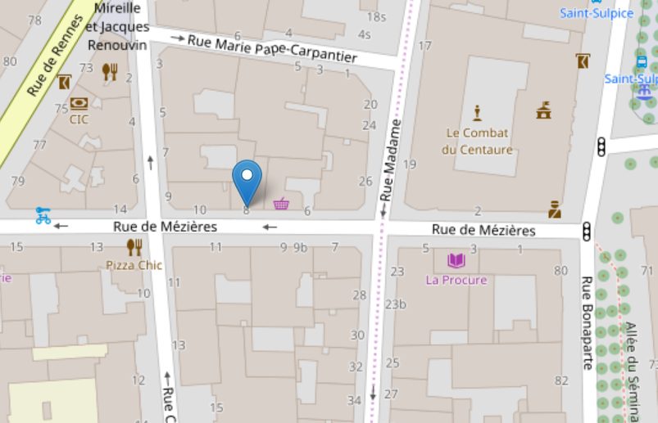
Geocoding
What is geocoding?
“8 rue de Mézières, Paris” →

Slide 4
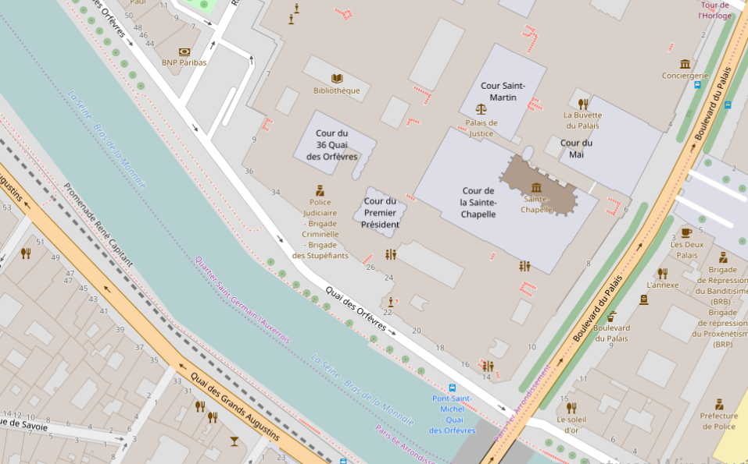
Historical geocoding
What is historical geocoding?
“5 rue de Jérusalem, Paris” ; 1846 →
Street doesn’t exist anymore

Slide 5
Historical geocoding
OK, I have a map from 1820-1840
Got to Bibliothèque Historique de la Ville de Paris
Start searching (for each address!)….

Slide 6
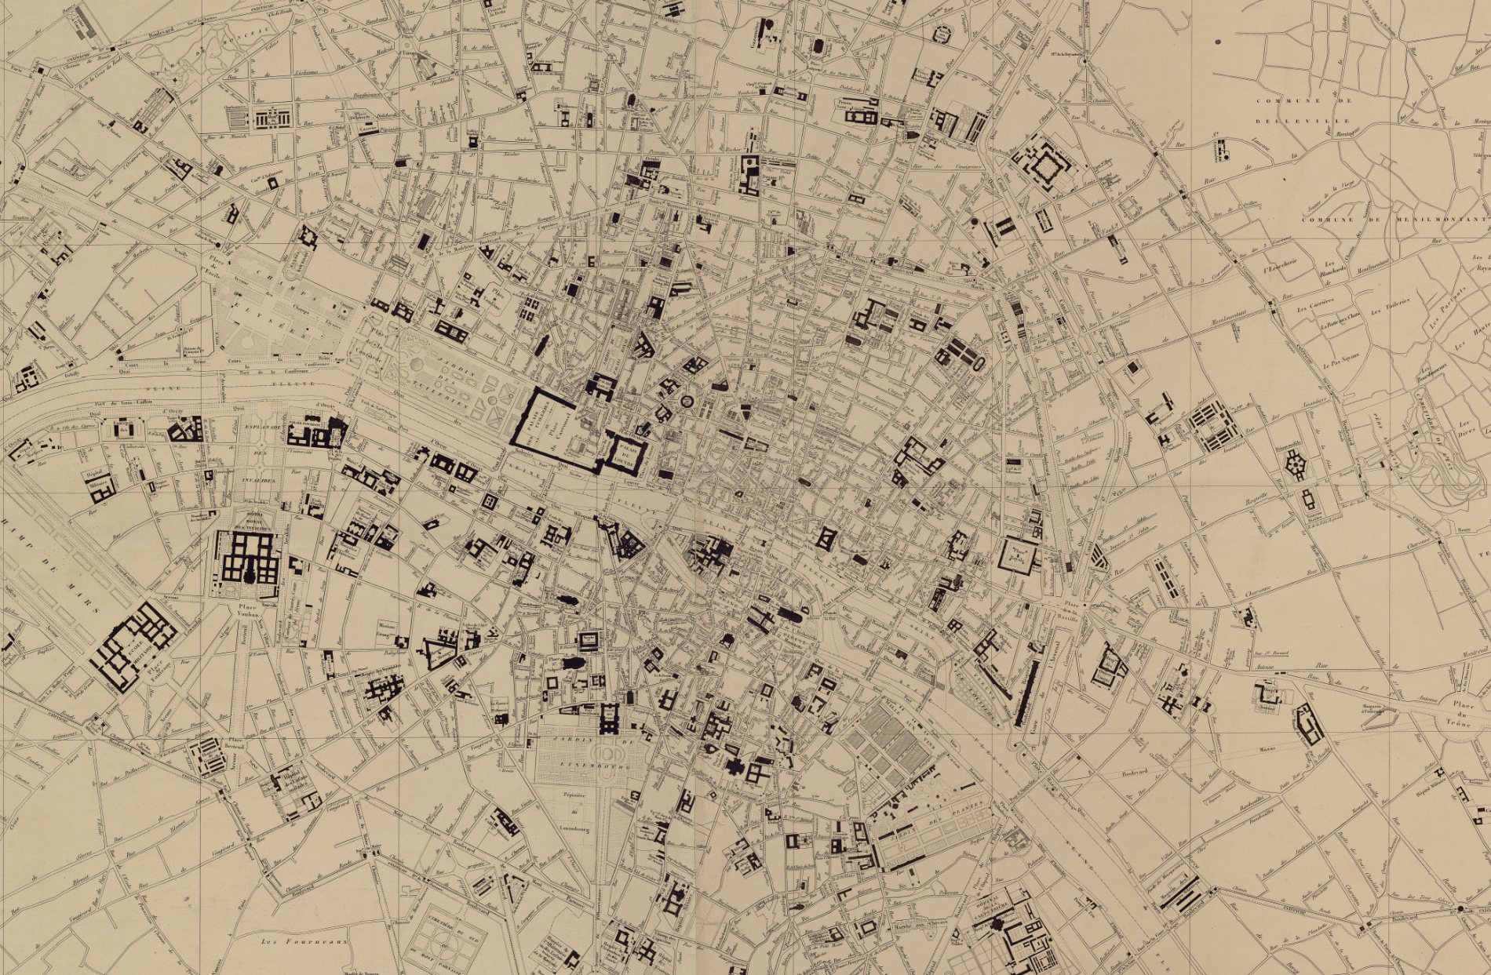
Historical geocoding
54 large sheets, good luck

Slide 7
Our method
Extract information from historical maps (street name, building number)
Construct gazetteers (geographical index ) (at this period, this street is here…)
Build a search function
A nice web interface for collaborative control and edit of results

Slide 8
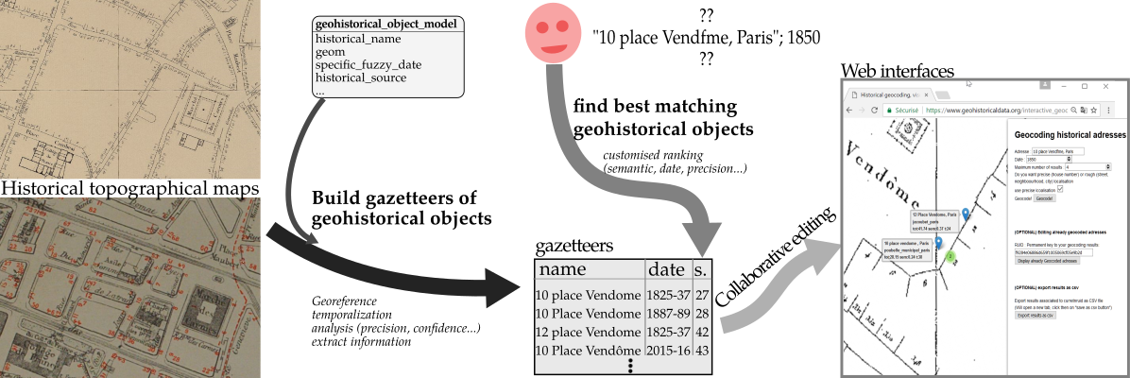
Our method
Proposed solution

Slide 9
Our method
Proposed solution

Slide 10
Historical maps
We want to extract information:
Street name and axis
Building number and position
…

Slide 11
Historical maps
Maps have to be georeferenced → can be used with other data.
Ex: for this room
Local : 200m SW of building entry
Georeferenced: 48°50'27.8"N 2°35'17.1"E
How does it work for historical map?
Complex
full PHD : Bertrand Dumenieu

Slide 12
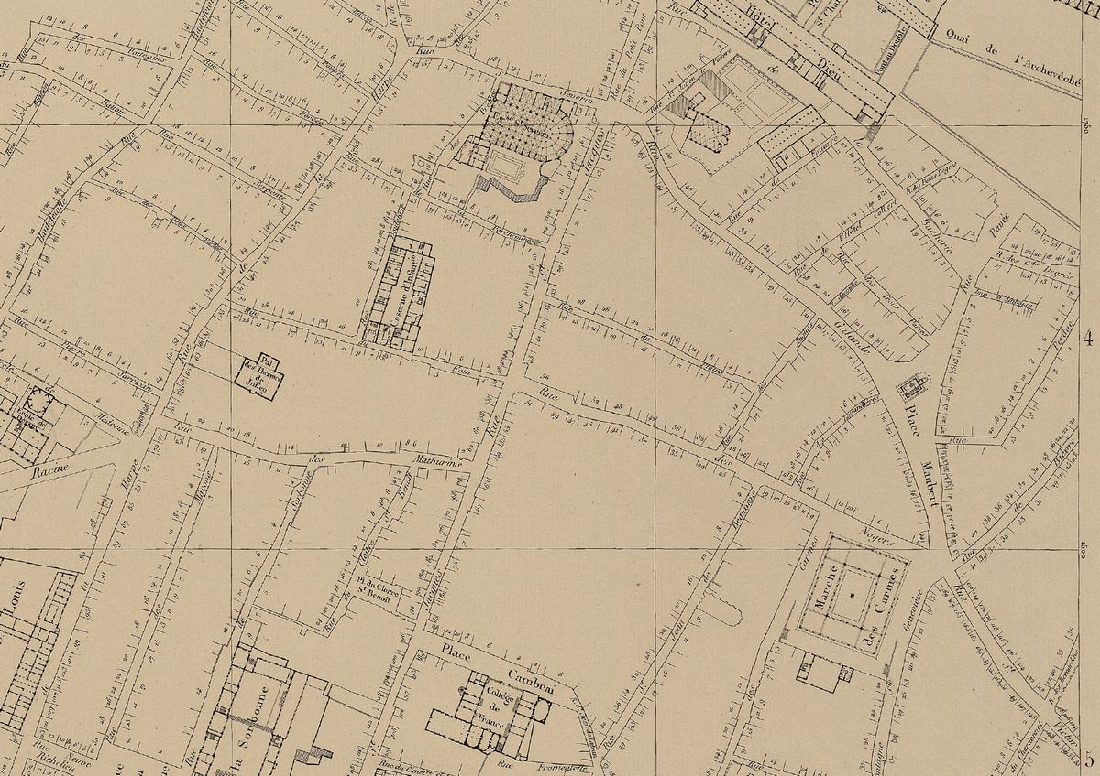
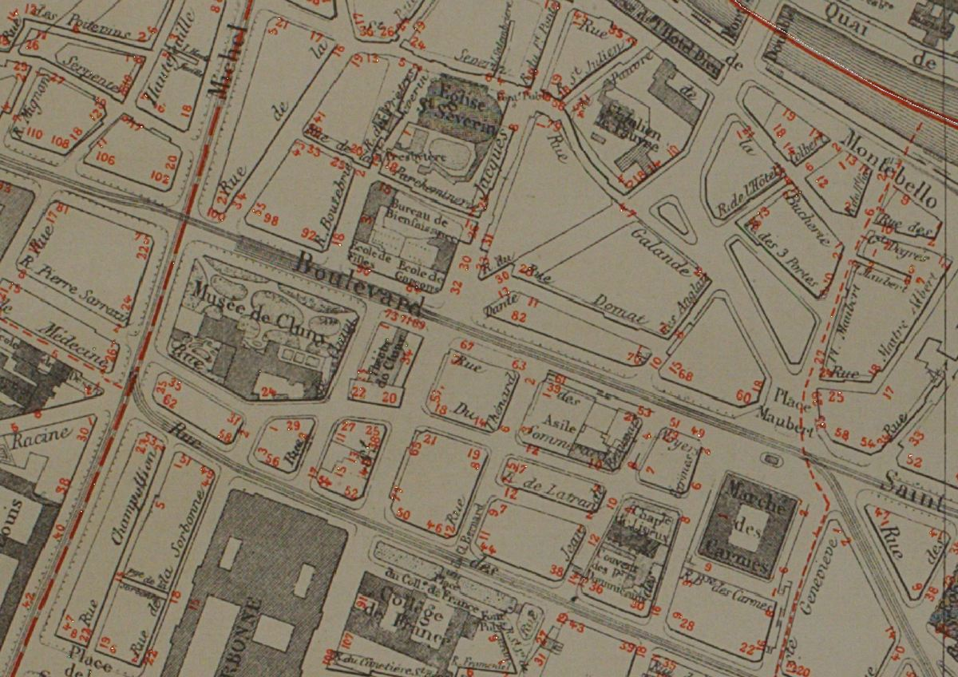
Historical maps
Matching points

Slide 13
Historical maps
Appropriate warping

Slide 14
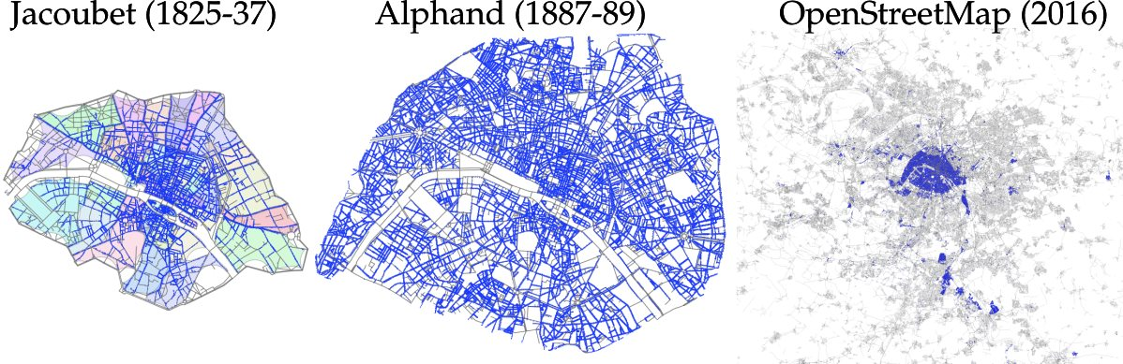
Historical maps
Extracting information
Mostly manual (collaborative)
Complex again : Full Phd : Benoit Costes

Slide 15
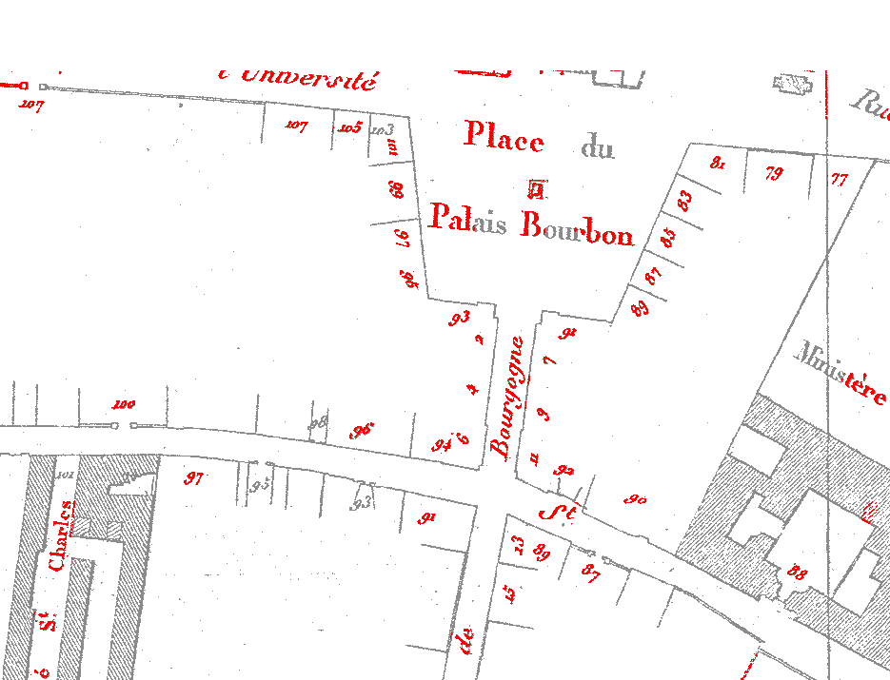
Historical maps
Extracting information
-Some test for automatic extraction : hard

Slide 16
GeoHistorical object
Model for extracted information :
Geohistorical object
geohistorical_object
Historical_source
numerical_source

Slide 17
GeoHistorical object
Model for extracted information :
Name + position
8 rue des Noyers, Paris

Slide 18
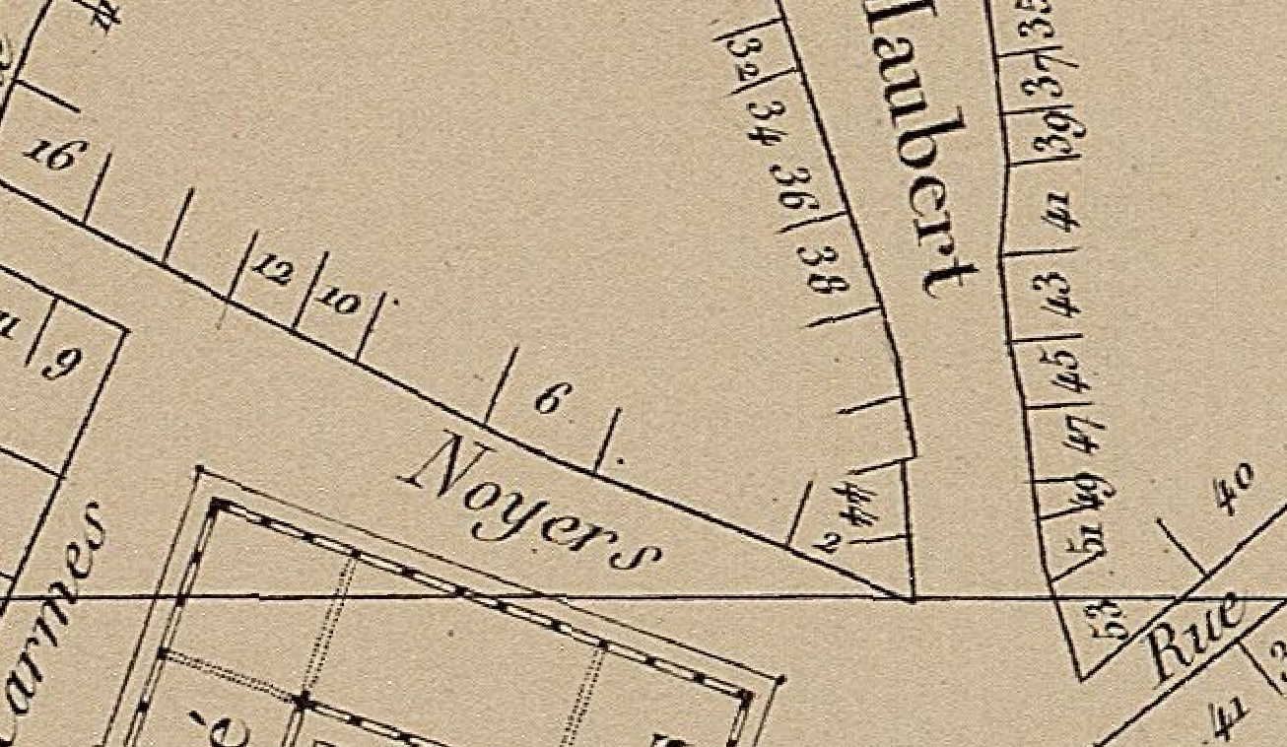
GeoHistorical object
Model for extracted information :
Historical source
8 rue des Noyers, Paris
Jacoubet Map, created … by …
Confidence…

Slide 19
GeoHistorical object
Model for extracted information :
Geohistorical object
8 rue des Noyers, Paris
1826-35
Jacoubet Map, created … by …
Confidence…

Slide 20
GeoHistorical object
Model for extracted information :
Digitizing process
8 rue des Noyers, Paris
1826-35
Jacoubet Map, created … by …
Confidence…
Digitized … Georeferenced … Editing process… Precision…

Slide 21
GeoHistorical object
Model for extracted information :
Full Geohistorical object
8 rue des Noyers, Paris
1826-35
Jacoubet Map, created … by …
Confidence…
Digitized … Georeferenced … Editing process… Precision…

Slide 22
Our method
Proposed solution

Slide 23
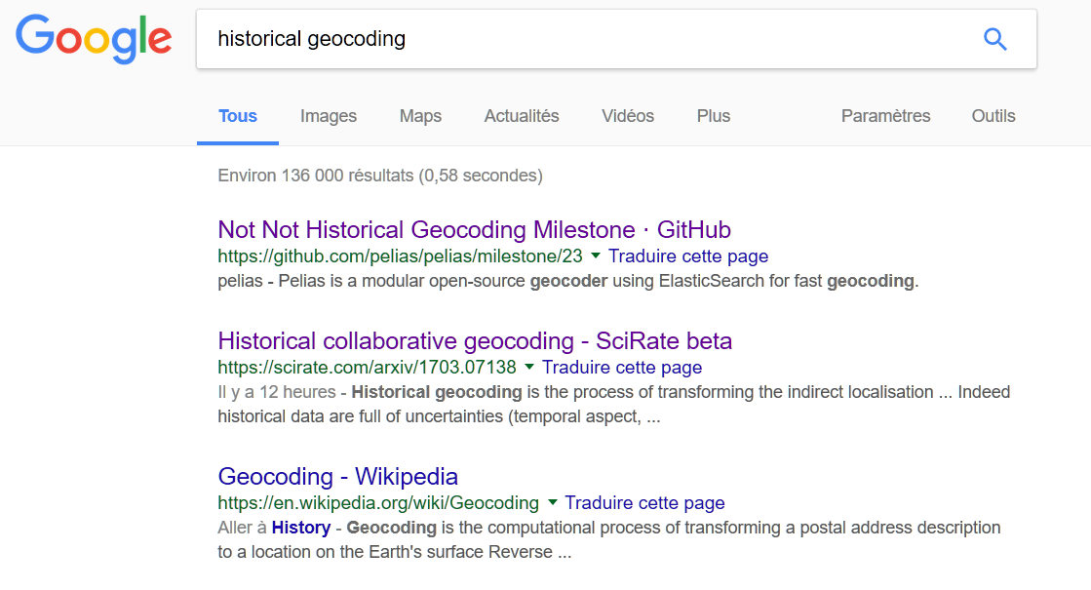
ranking
Geocoding is then all about ranking

Slide 24
ranking
Ranking metrics?
10 place Vendôme, Paris ; 1850
Semantic : how close are the text (trigrams)?
12 pl. Vendome, Paris ; 1870

Slide 25
ranking
Ranking metrics?
10 place Vendôme, Paris ; 1850
temporal : how close are the (fuzzy) dates?
12 pl. Vendome, Paris ; 1870

Slide 26
ranking
Ranking metrics?
10 place Vendôme, Paris ; 1850
Building number: distance including parity?
12 pl. Vendome, Paris ; 1870

Slide 27
ranking
Ranking metrics?
10 place Vendôme, Paris ; 1850; precision=10m
Spatial precision of source
12 pl. Vendome, Paris ; 1870; precision=2m

Slide 28
ranking
Ranking metrics?
Quartier Vendôme, Paris ; 1850;
Geographique Scale
12 pl. Vendome, Paris ; 1870;

Slide 29
Collaborative editing
Proposed solution

Slide 30
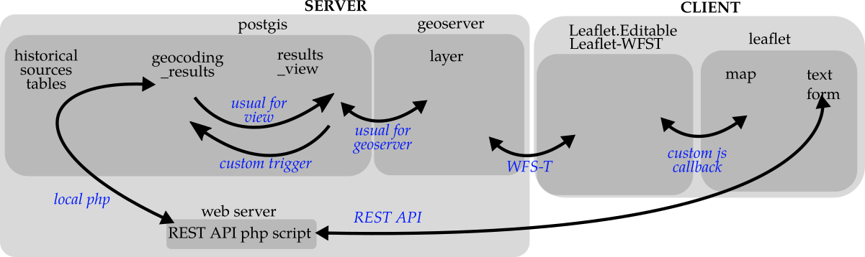

Collaborative editing
Whole web stack …

Slide 31
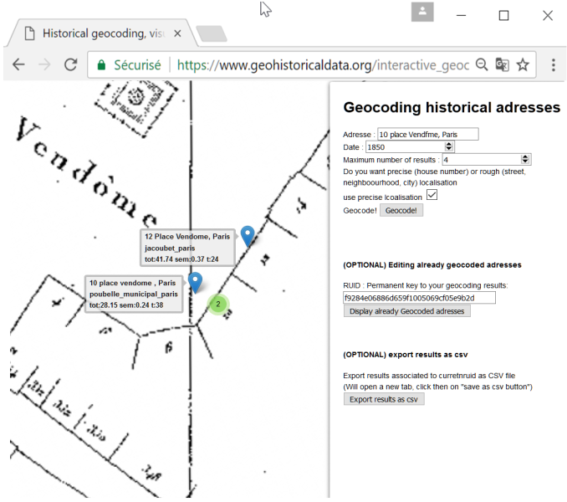
Collaborative editing
Edit are stored and used by geocoder

Slide 32
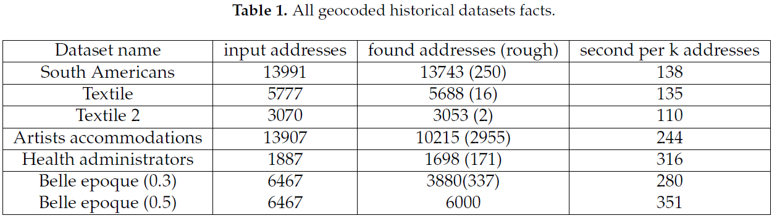
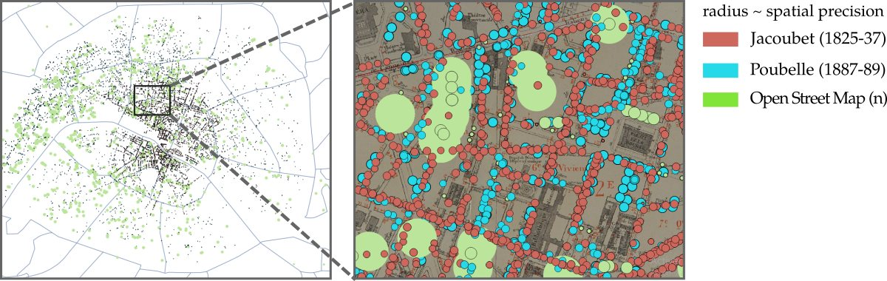
Results
Thousands of historical addresses geocoded

Slide 33
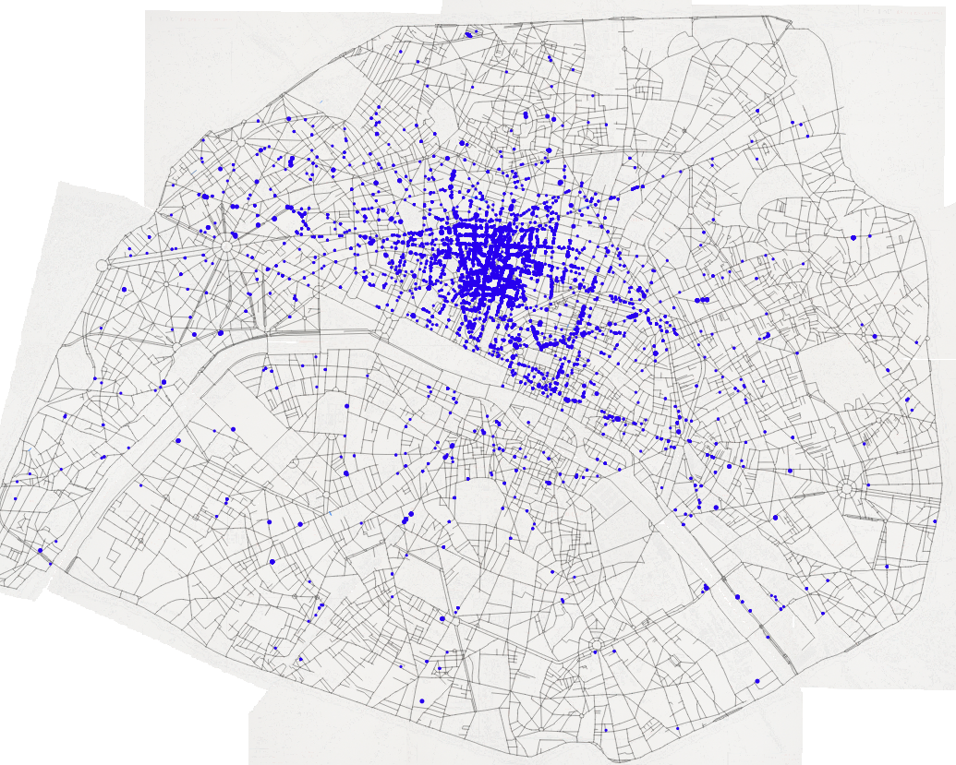
Results
Example : Bottin by Theo
17878 address with street name
17474 found ( including 175 streets) : 98%

Slide 34
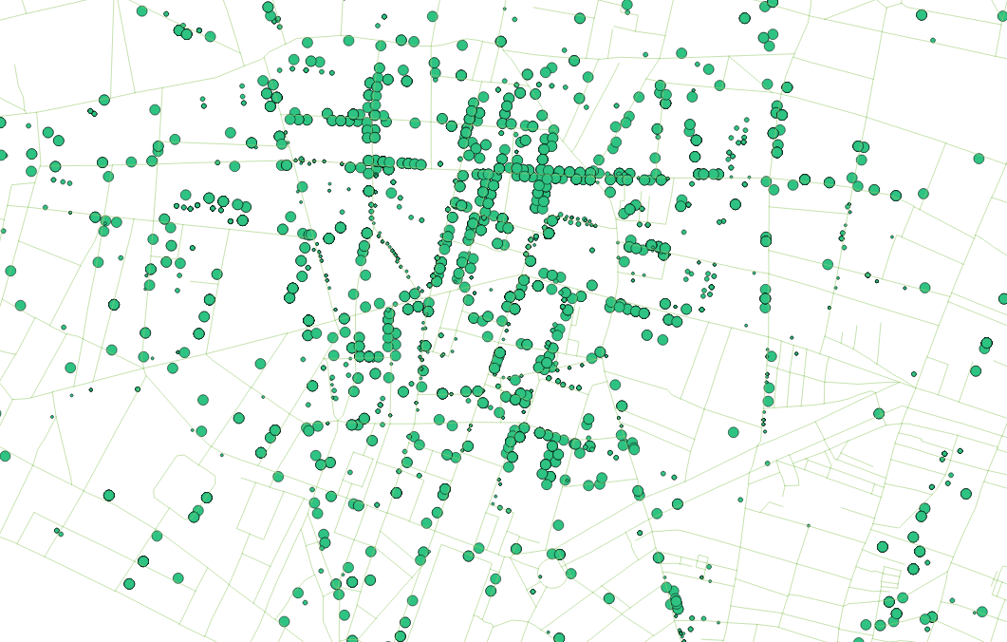
Results
Full bottin : fuzzy results

Slide 35
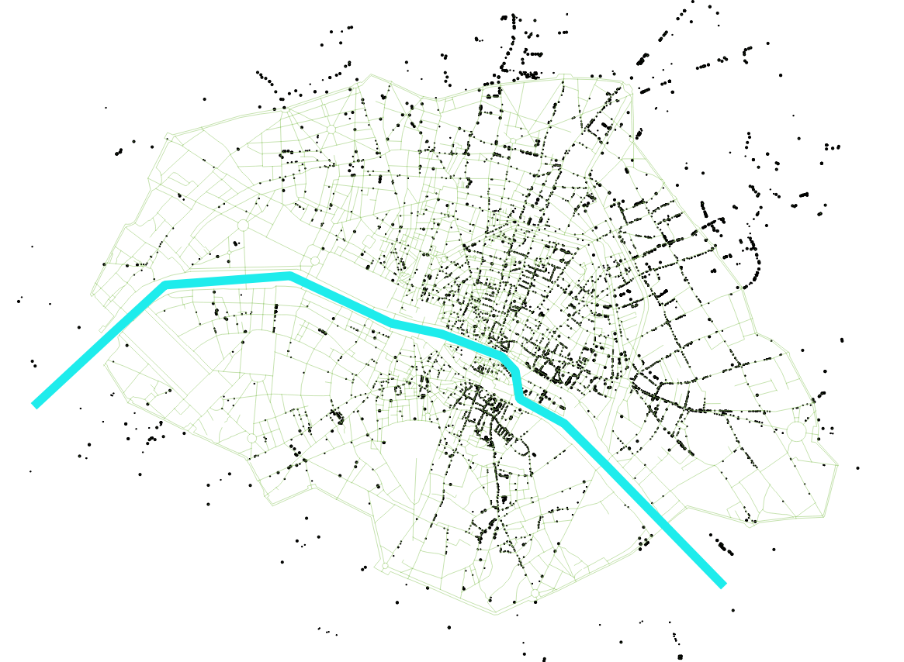
Results
Using various EHESS datasets
People arrested in 1848

Slide 36
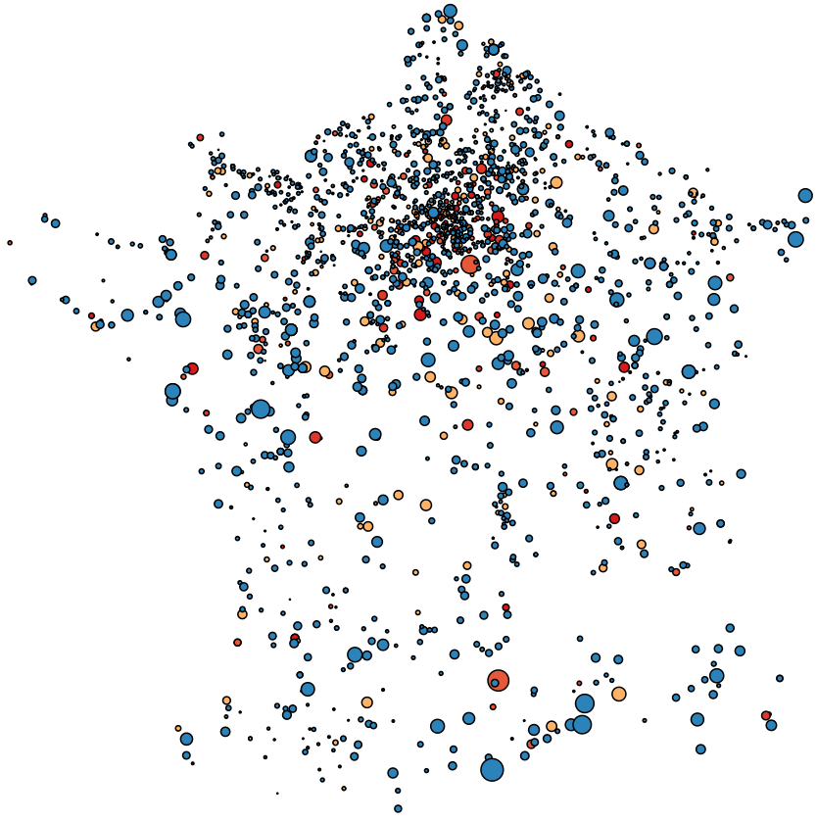
Results
Also works on other scales

Slide 37
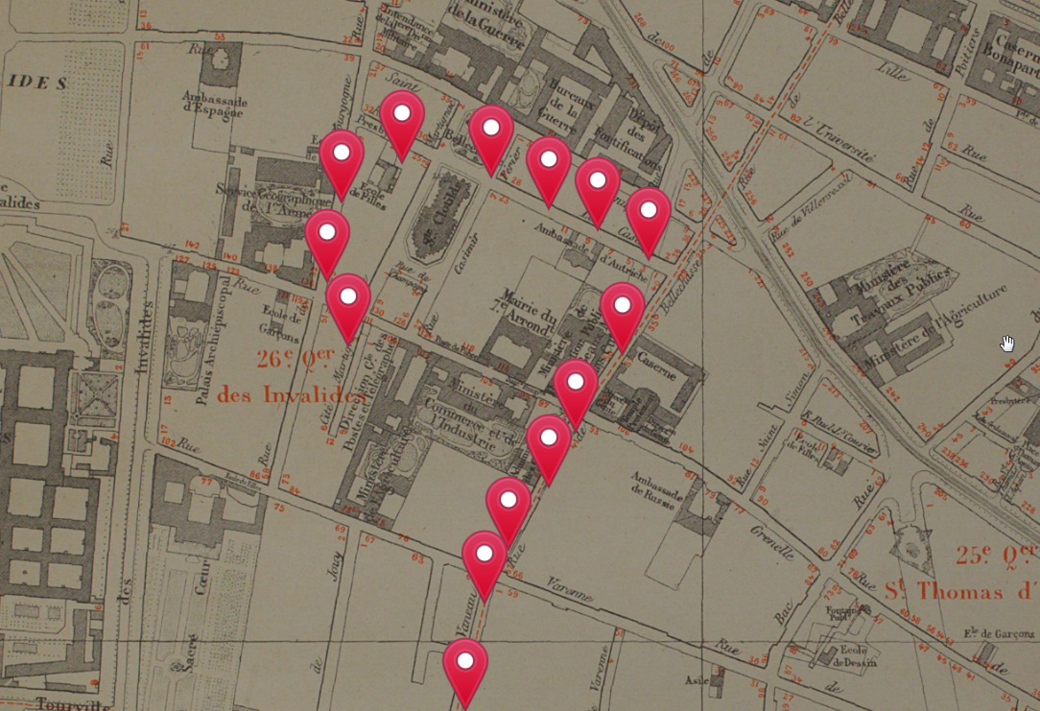
Conclusion
After this:
Historian work!

